Slide 1


MATLAB & Simulink workshop
Made by: Youssef Ahmed

Slide 2

Session 7
Arduino with Simulink

Slide 3


Last session recap

Slide 4
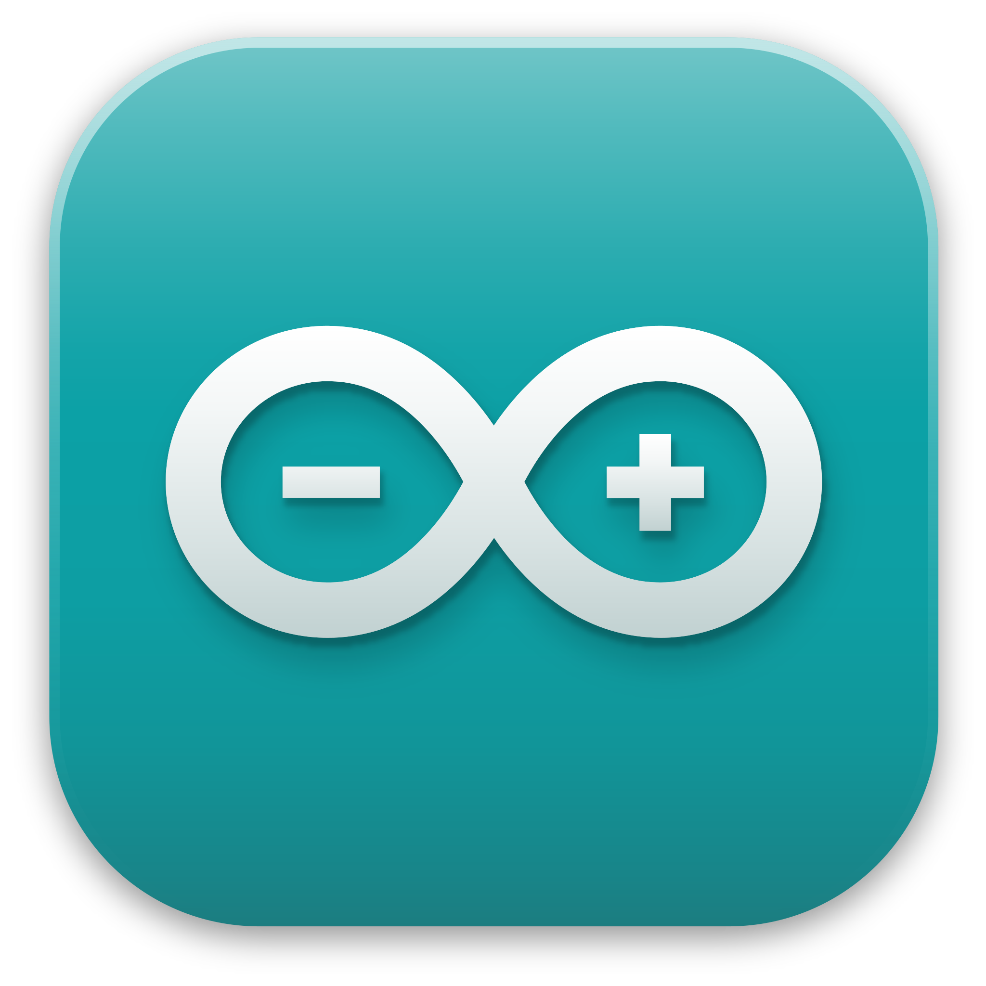
What is Arduino?

Slide 5
Arduino with Simulink
What is Arduino??

Slide 6
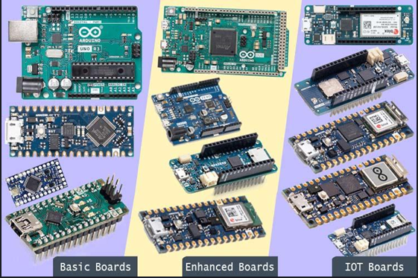
Arduino with Simulink
Arduino boards

Slide 7
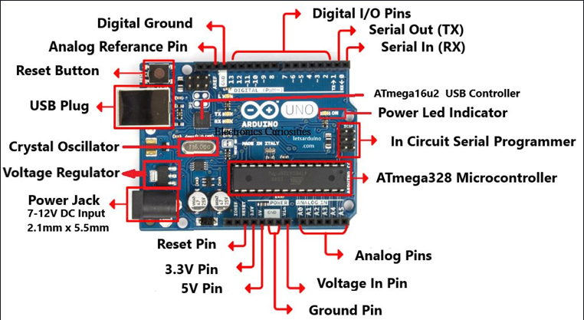
Arduino with Simulink
Arduino Uno

Slide 8
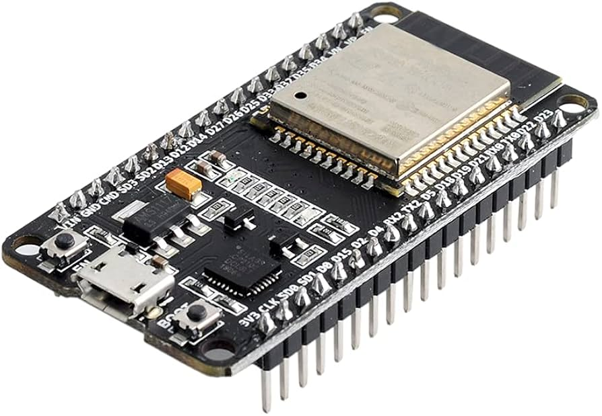
Arduino with Simulink
ESP32 Dev-board

Slide 9
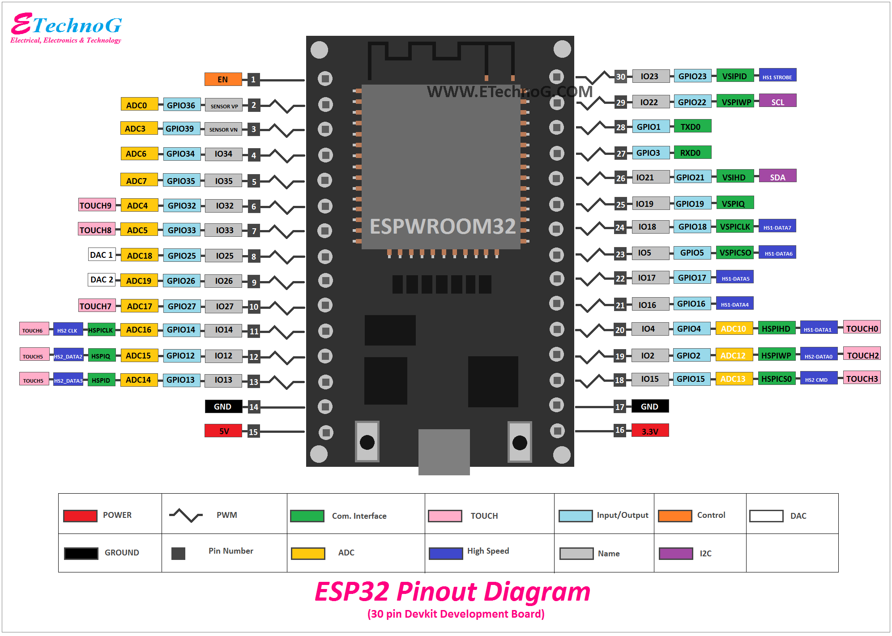
Arduino with Simulink
ESP32 wroom32 (30-pin)

Slide 10
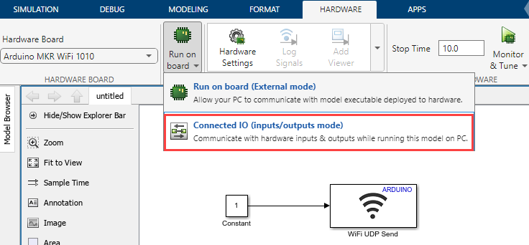
Arduino with Simulink
Who actually process the Simulink model??

Slide 11

MATLAB time!
Now let’s see what we covered so far in MATLAB

Slide 12
Thank you!

